Slide 1
Senior Project Design Review
Project Name: Adjustable Arm Prosthetic (AAP)
Team: Basel Abumailish, James Briscoe, Eric Carlos
Course(EE490/BIO490AL) SCIT

Slide 2
Problem/Motivation
Upper-limb amputees often face limited access to prosthetic devices that are affordable, adjustable, and functional. Many existing prosthetics are either too expensive, lack adaptability as the user grows or changes, or provide limited hand articulation. This can reduce usability and make everyday tasks difficult or uncomfortable.
Our project aims to address these limitations by designing a low-cost, adjustable arm prosthetic that provides functional hand motion while allowing for mechanical and electrical customization.
The motivation behind this project is to create a prosthetic system that balances functionality, affordability, and adaptability. By using modular mechanical components, internal cable routing, and accessible electronics, the design focuses on improving durability, comfort, and ease of use while remaining feasible for rapid prototyping and iteration.

Slide 3
Problem/Motivation
Requirements and Constraints
Adjustable forearm length to accommodate different users
Functional finger articulation with internal cable routing
Safe and reliable actuator control
Compact integration of electronics within the forearm
Budget, time, and manufacturability constraints
Use of readily available components and 3D-printed parts
System Architecture
Biomechanical subsystem: Fingers, palm, adjustable forearm, self-lacing mechanism
Electrical subsystem: Microcontroller, motor driver, actuators, power supply
Firmware: Motor control logic, safety expansion, and actuator coordination

Slide 4
Hand Anatomy and Design Relevance
Key Structure Considered
The human hand contains multiple joints that enable bending and gripping
Knuckle placement guides where mechanical joints are positioned
The palm provides structural support during grasping
Thumb positioning is critical for holding objects
Design Impact
Mechanical joints are aligned with natural finger joints
The palm is reinforced to handle gripping forces
The design supports realistic hand movement rather than rigid motion
Engineering Goal
Replicate essential hand structure to support functional movement

Slide 5
Physiological Principles
How the Hand Functions
Muscles generate force to move the fingers
Tendons transfer that force to create motion
Multiple fingers must move in coordination
The body limits joint movement to prevent injury
How it is Implemented
Actuators replace muscle force
Internal cables mimic tendon behavior
Firmware enables coordinated finger control
Mechanical stops help prevent overextension
Engineering Goal
Convert biological movement principles into safe, controlled mechanical motion

Slide 6
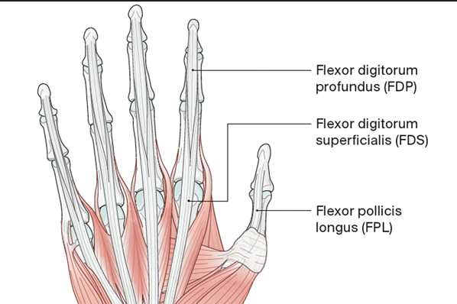
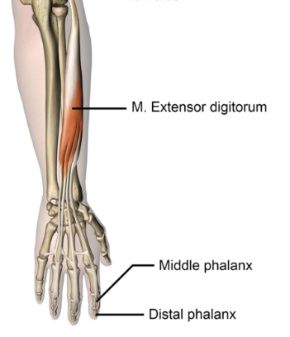
Biology to Engineering
Flexor Digitorum Profundus
Tendon that bends the fingertip during gripping
Cable system pulls the finger inward to replicate gripping motion
Flexor Digitorum Superficialis
Tendon that bends the finger joints for controlled grasping
Finger joints are designed to allow gradual bending instead of rigid motion
Extensor Digitorum
Tendon responsible for straightening the fingers
Motor reversal to allow the prosthetic fingers to reopen
Design Focus
Replicate tendon-driven force transmission to produce controlled and natural finger motion

Slide 7
Engineering Progress
Finger joint design completed
Telescoping rod mechanically verified
Palm modeling in progress
Bracket design underway
Firmware operational in simulation
Electronics layout validated
Circuit design verified in simulation

Slide 8
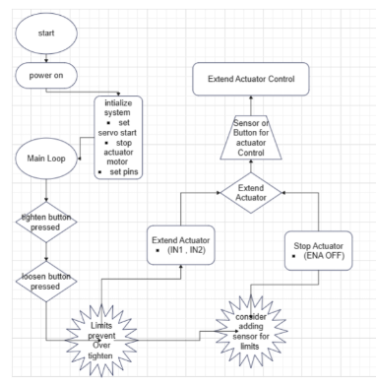
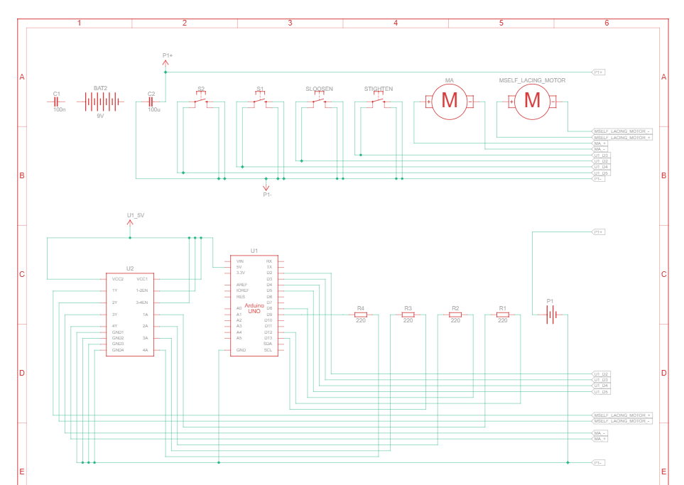
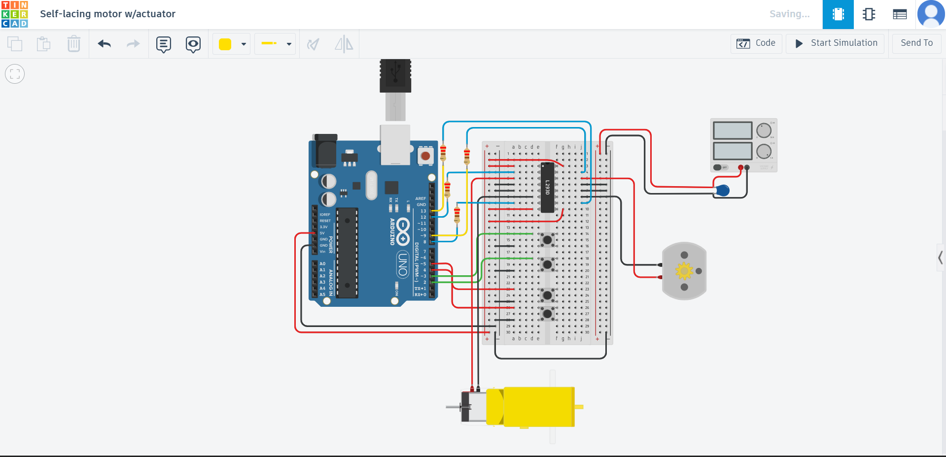
Circuit Progress
Circuit Design & Schematic

Slide 9
Firmware / Software Progress
Current Status
Base firmware has been developed to control motors and actuators
Code has been tested using Tinkercad to verify basic functionality and verified by MR.Lin
Motor response and control logic behave as expected in simulation
What We’ve Verified So Far
Actuators respond correctly to control inputs
Motors can be independently controlled
Basic forward and reverse operation works as intended
Ongoing Development
Adding safety features such as emergency stop logic / Sensors
Getting the firmware ready to work with the full 3D-printed arm assembly
Making adjustments based on how the printed joints and cable routing behave in practice
Planning support for additional sensors and safety features during physical testing
Moving from basic functionality toward full subsystem integration

Slide 10
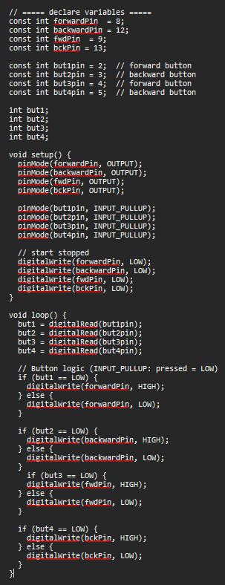
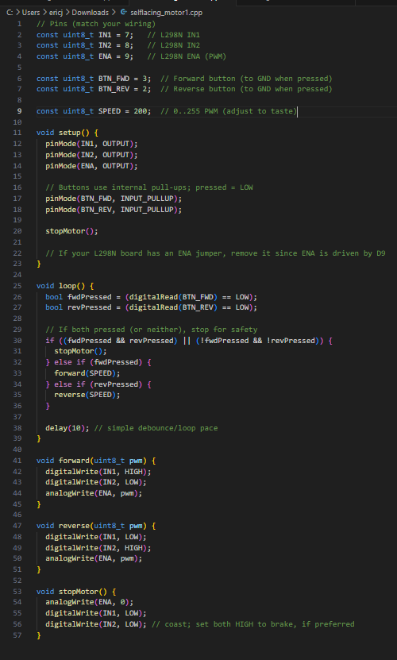
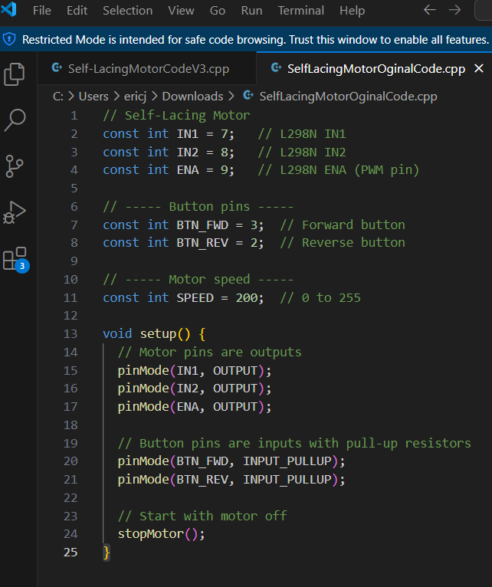
Preliminary Design
First Dual Motor Code→ Functional New→
Dual Motor Code
Original Base Code

Slide 11
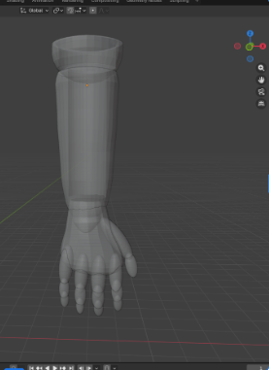
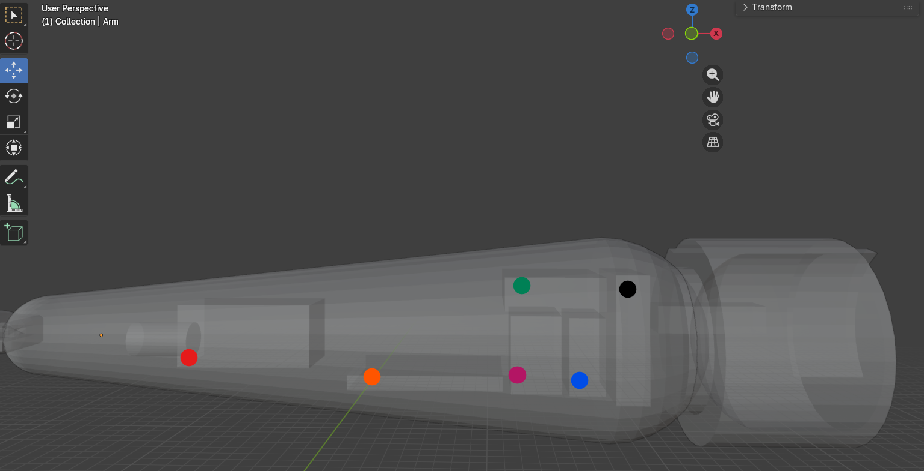
Measurements of all electronic components have been taken and will be inset into the model.
Red: Linear actuator
Orange: Bread board
Purple: Motor Driver
Green: Arduino Board
Blue: Micro Server
Black: Battery Pack

Slide 12
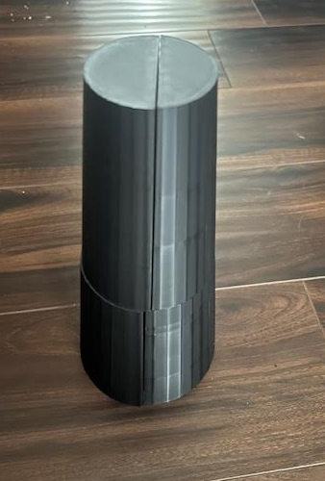
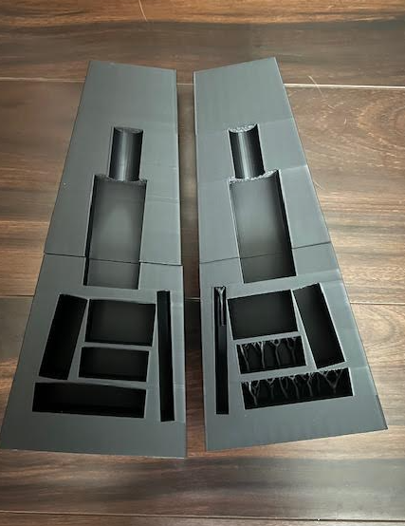
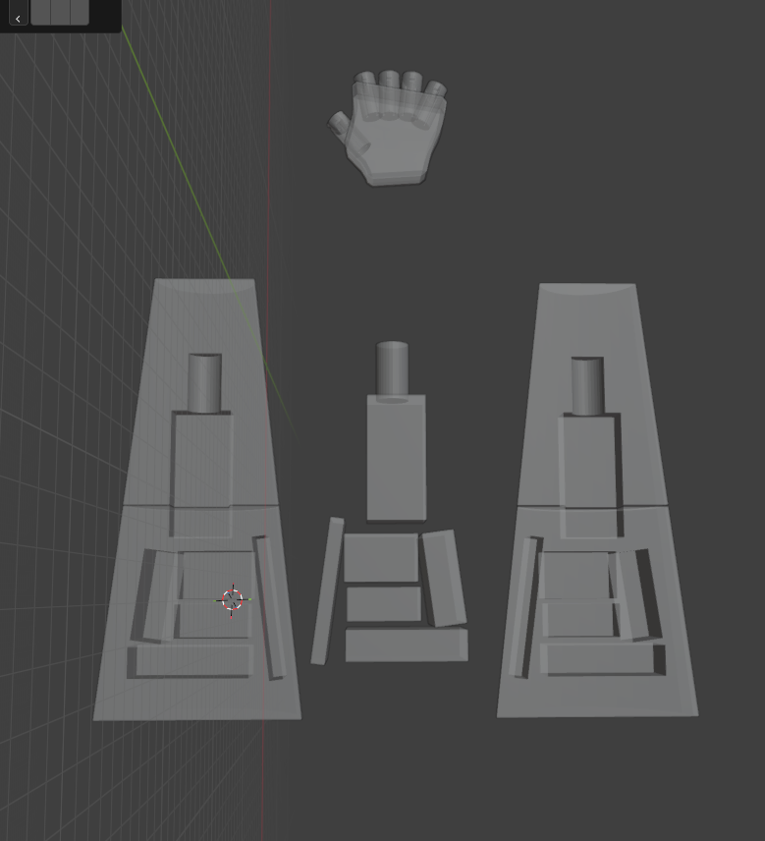

Slide 13
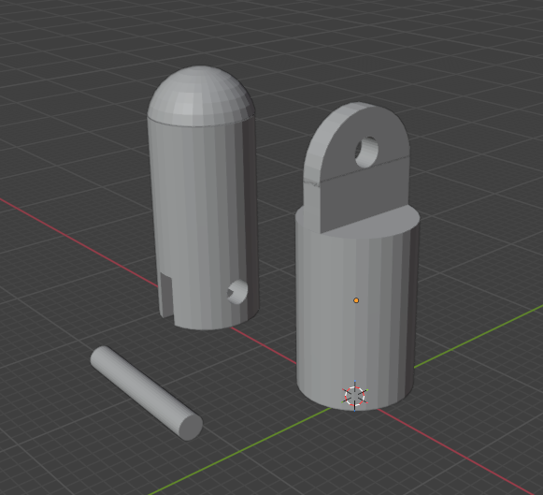
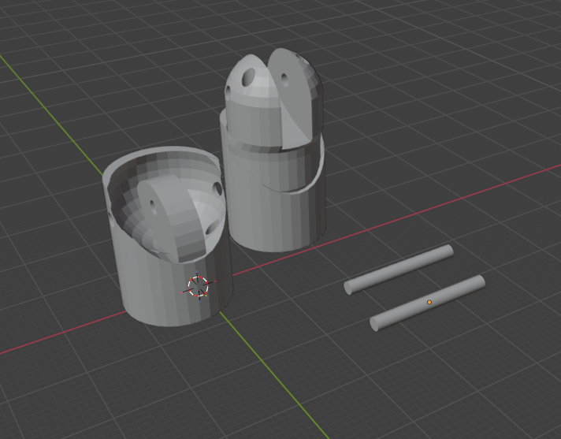
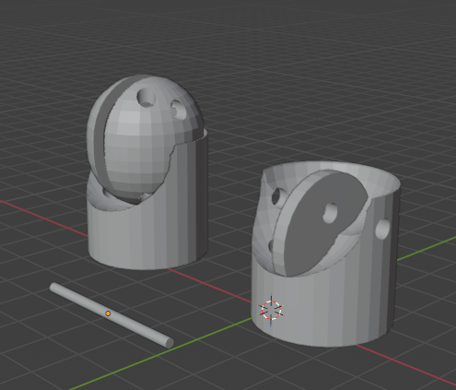
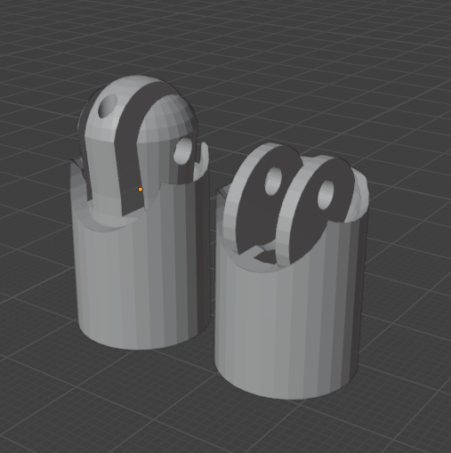
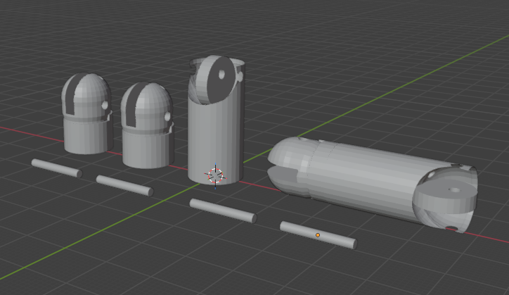
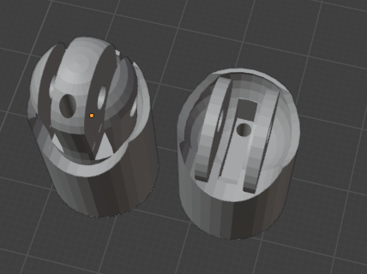

Slide 14
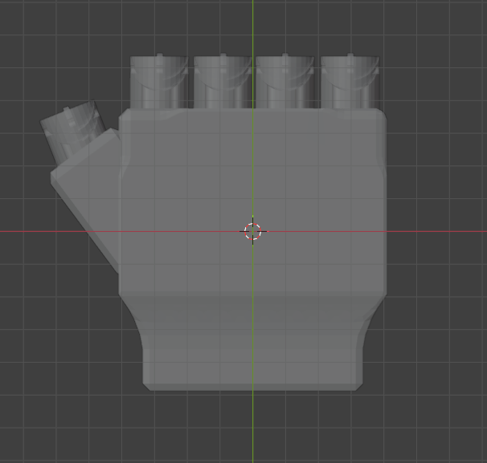
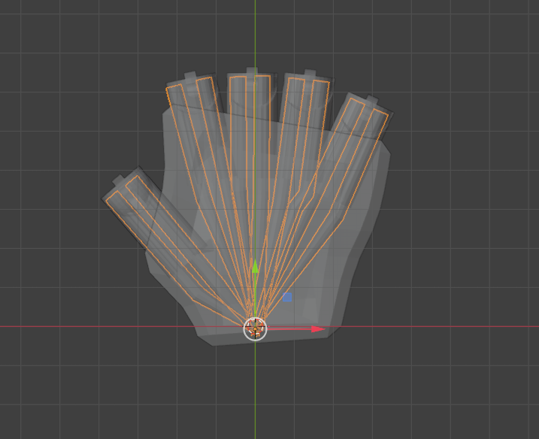
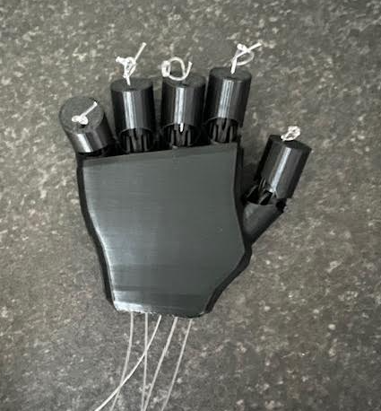
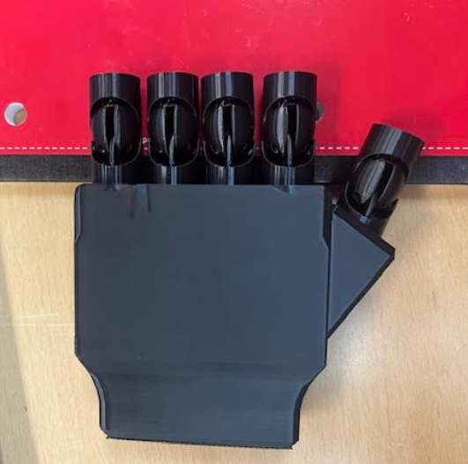

Slide 15
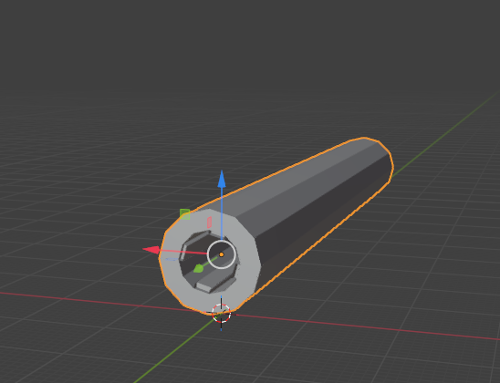
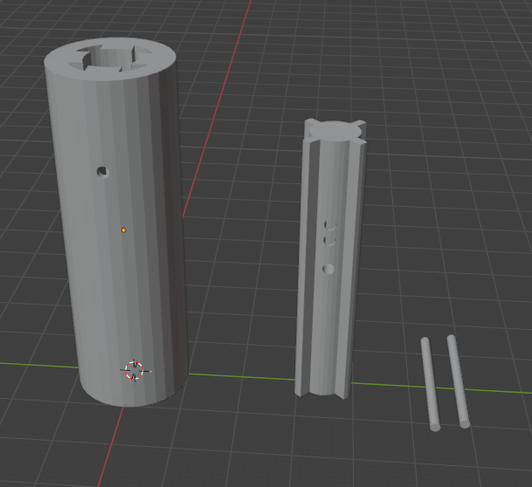
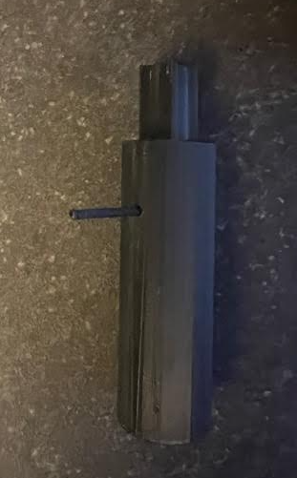
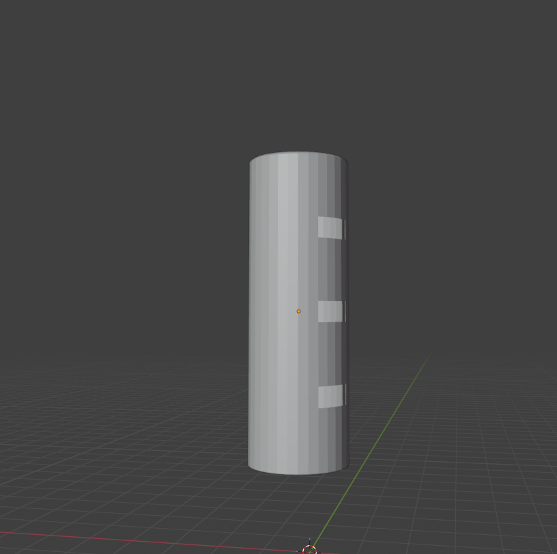
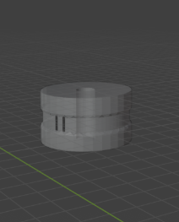
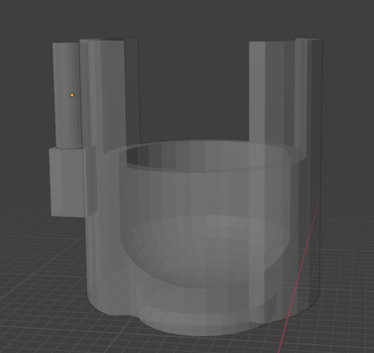

Slide 16
Verification plan and status
Verification Approach
Subsystem-level verification before full system assembly
Mechanical verification through 3D test prints and physical fit checks
Electrical and firmware verification using Tinkercad simulations
Current Status
Finger joints and extending rod mechanically verified
Motor control and actuator logic verified in simulation
Full system integration verification planned for next milestone
Schedule Impact
Minor delays due to design iteration and fit adjustments
Overall schedule remains on track based on milestone completion dates

Slide 17
System Integration
Interfaces
Actuators: Linear actuator and motors driving finger cable system
Sensors (planned): Emergency stop and future safety inputs
Communications: Direct microcontroller control (no external comms yet)
Control Signals: PWM for motors and actuators
Error Handling & Logging
Manual emergency stop planned for physical testing
Error handling will be expanded as sensors are added

Slide 18
System power integration
Power Budget
Rechargeable Battery pack selected based on actuator and motor requirements
Power routing reviewed to prevent interference and backfeeding
Thermal Considerations
Motor driver and actuator placement designed to reduce heat buildup
No thermal issues observed during simulation testing
Thermal behavior to be verified during physical operation
ADC / DAC Resolution
Sensor resolution requirements identified for future emergency stop integration

Slide 19
Integrate use of commercial modules
Cost vs Performance
Commercial motors, motor drivers, and microcontroller were selected to meet functional requirements while keeping overall system cost low
Performance is sufficient for finger actuation and self-lacing without over engineering
Size vs Cooling
Compact commercial components were chosen to fit inside the forearm housing
Component placement was planned to allow airflow and reduce heat buildup
No thermal issues observed during simulation testing
Accuracy vs Bandwidth
Motor control accuracy provided by commercial drivers is adequate for prosthetic motion
High-speed bandwidth was not prioritized, as smooth and controlled movement is more important than rapid response

Slide 20
Integrate use of commercial modules
Complexity vs Schedule
Using commercial modules reduced development complexity
Allowed the team to focus on mechanical design and system integration
COTS (Commercial Off-the-Shelf) vs Custom
COTS components used for electronics and actuation to reduce risk
Custom design effort focused on 3D-printed mechanical components and cable routing
Custom design: Fingers, palm, adjustable forearm, telescoping rod, self-lacing mechanism
Cost
The custom arm design uses 3D-printed parts to reduce manufacturing cost
Modular mechanical design allows easy modification without replacing electronics

Slide 21
Test and Validation
Test Conditions
Bench-top testing of 3D-printed mechanical components
Physical test prints used to evaluate finger joints and extending rod
Circuit and firmware tested using Tinkercad simulations
Incremental testing performed before full system integration
Pass / Fail Targets
Finger joints bend to the required range of motion
Telescoping rod extends and locks securely
Motors and actuators respond correctly to control inputs
Cable routing allows smooth line movement without binding
Observed Errors
Initial finger joint designs limited range of motion
Firmware required refinement to support multiple motors
Cable routing in the hand caused line feeding issues

Slide 22
Risk and mitigation
Supply/ Lead time:
All parts have already been ordered and delivered
Remaining parts are all 3D printed
EMI/ESD issues:
Capacitors being used for filtering
Silicone will also be used in housing cavities
Thermal margin:
The battery under normal operation can get warm (~20-30C)
The melting temperature of the PLA (150-180C)
Consideration will be taken with heat vents to ensure the battery doesn't reach critical temperatures

Slide 23
3D Print Considerations/ Biomaterial
PLA: Safe for extended skin contact
Strength of PLA: current infill 15% final will be 50% infill to increase strength with extra interior walls
Print orientation: final prints will be printed horizontally to create more resistant against downward force (perpendicular not parallel)
PLA: biocompatible with human skin but small ridges of 3D printing will be taken into account
Silicone: Safest for extended skin contact without irritation

Slide 24
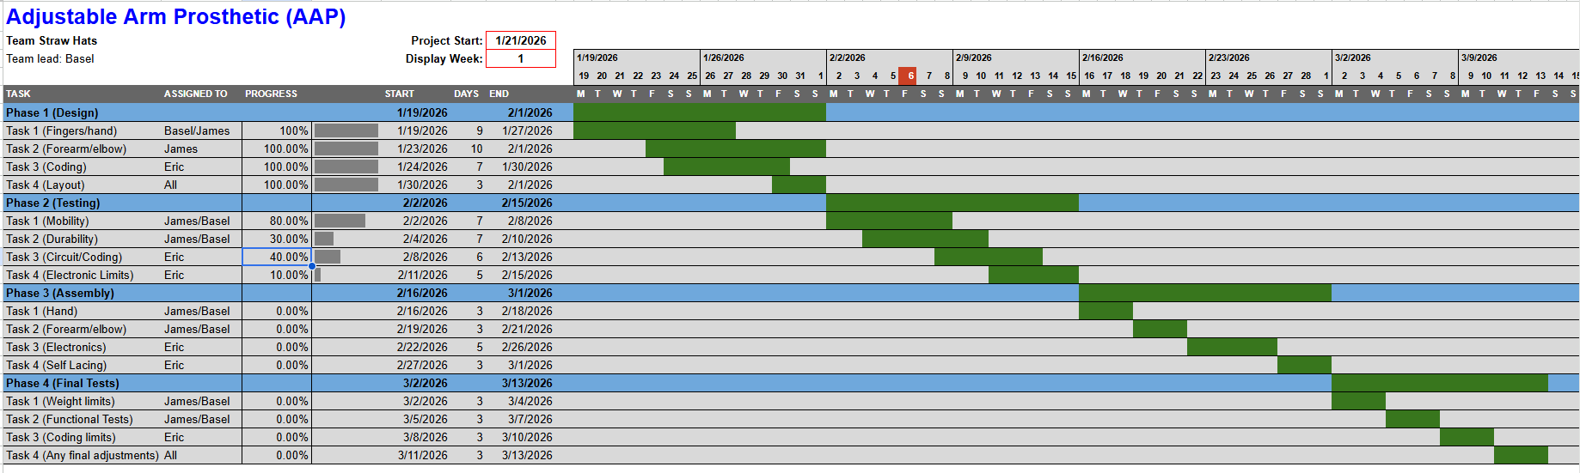
Gantt chart

Slide 25
Budget Table
Item | Cost
Arduino Uno | $27
Linear actuator | $30
Motor Driver | $10
Servo Motor | $15
Bread Board | $5
Resistors | $5
Capacitors | $5
Battery Pack | $15
PLA | $20
Actuator | $35
Silicon Bands | $8
Total:
$175

Slide 26
Team collaboration chart
Member | Contributions | Notes
Basel | Joint design, Self-lacing mechanism brackets planning, biomechanical research
James | 3D printing, Finger design, Hand design, Telescoping rod design, prosthetic design, prosthetic layout, biomechanical research, biomaterial research
Eric | Circuit design, github, schematics,flowchart,wiring and testing,coding,Electrical Research

Slide 27
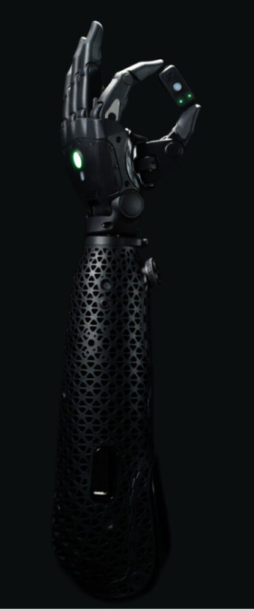
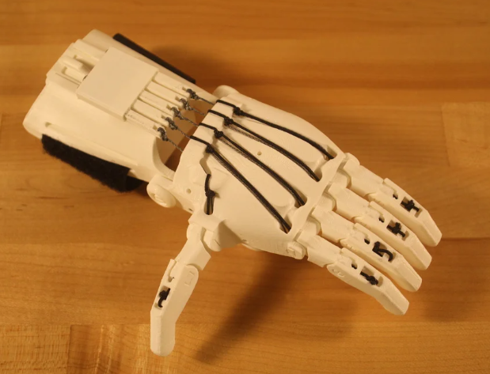
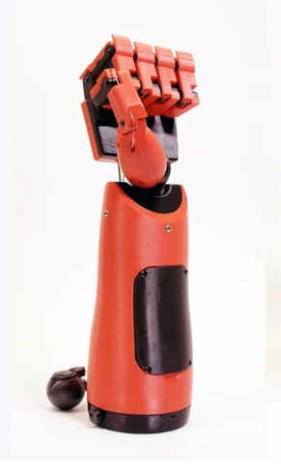
Similar products
Open Bionics Hero
$6,000
Enable 3D Printed and another 3D printed hand

Slide 28
Questions??

